Slide 1
INFS 740 Presentation
Sravishtta Kommineni

Slide 2
Projects
Project 1 - Google AdWords API
Project 2- Stocker (hands-on with tools)

Slide 3
Google AdWords API idea
Many of the advertisers use a trial-and-error when setting various settings like the following:
Target gender
Target age
Budget
Location
etc...

Slide 4
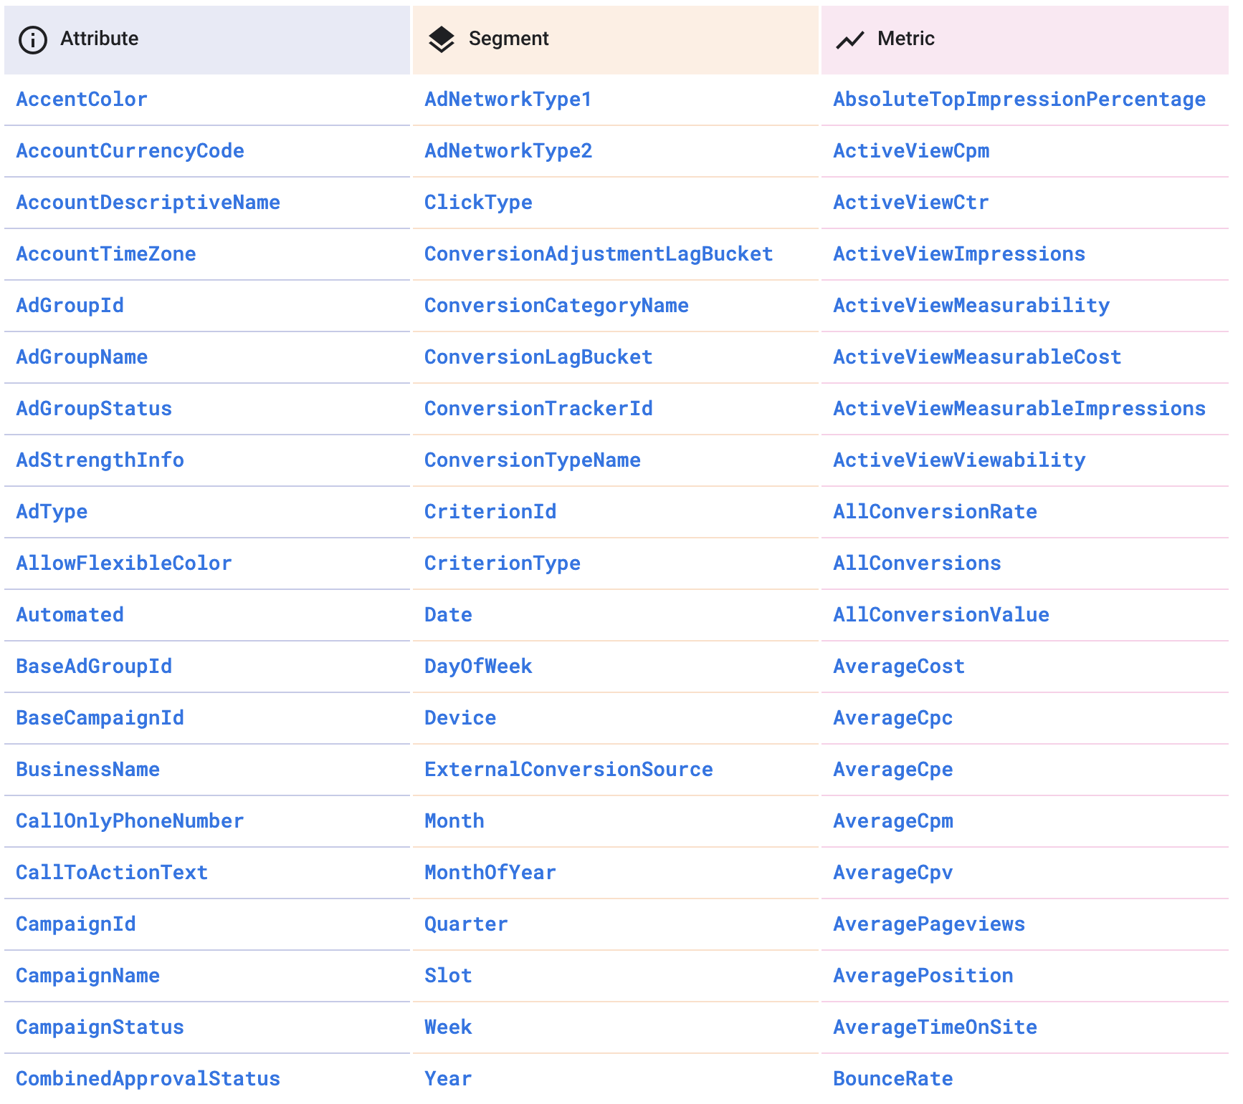
Metrics returned from the API
We can use Google’s own query language in order to query reports
AdWords Query Language (AWQL)
Reports include:

Slide 5
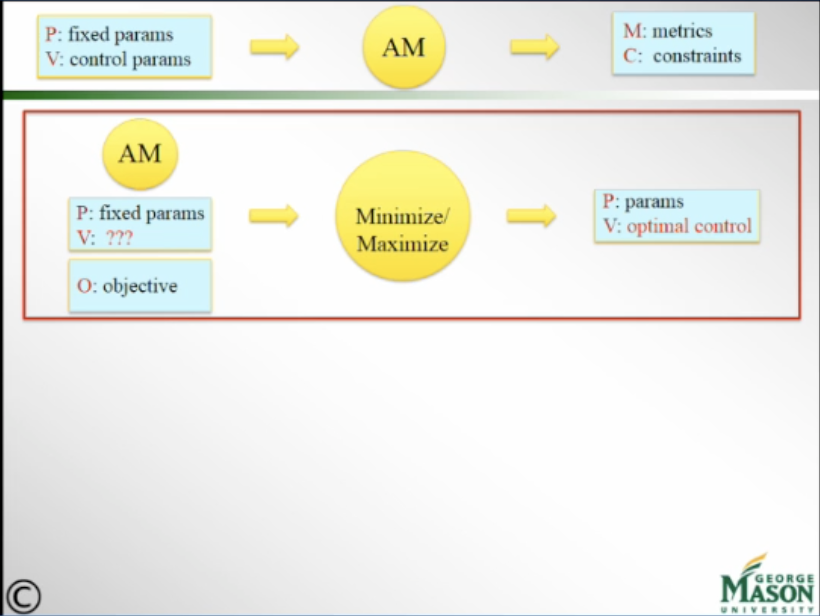
Purpose
The purpose is to design an analytical model, very similar to the analytical model Professor Brodsky was talking about in his decision guidance systems.

Slide 6
This was the overall idea of the idea Dr. Brodsky and I discussed
For the scope of this class, the idea was to programatically set up an Ad Campaign through the Google AdWords API
These are the steps needed to do that:
Request Developer Token (takes 2-5 days)
Create a test manager and test manager account
Set-up OAuth2 Access
Configure client application
Make API Request

Slide 7
Problems
Had to wait 5 days for the developer token
Could not properly set up the test manager account, and could not find enough resources to solve this problem.
But, I do want to work with Dr. Brodsky next semester towards the analytical model, which optimizes the control inputs based on prior data towards an objective for advertising.

Slide 8
Project 2: Stocker

Slide 9
Technologies Used
ReactJS - Front-end
Firebase Authentication - User Authentication with e-mail and password
Cloud Firestore - Database
Financial Modeling Prep API - for retrieving real-time stock data.

Slide 10
Demo

Slide 11
Thank you

